Slide 1
IMAGE CAPTION GENERATOR USING CNN-RNN
Guide: submitted by:
Vaheetha salam Shifin.t.k(27)
vivek viswam(32)
Jincy joy(45)

Slide 2
contents
INTRODUCTION
REQUIREMENTS
ARCHITECTURE
CNN
LSTM
MODULAR DIVISION OF THE PROJECT
CURRENT STATUS
REFERENCE

Slide 3
Introduction
Image caption generator is a task that involves computer vision and natural language processing concepts to recognize the context of an image and describe them in a natural language like English.
The objective of our project is to learn the concepts of a CNN and LSTM model and build a working model of Image caption generator by implementing CNN with LSTM.
This model can perform two operations.
The first one is to detect objects in the image using convolutional neural networks and the other is to caption the images using RNN based LSTM.

Slide 4
Requirements
Prerequesties: tensorflow, keras, numpy, Python3
Dataset: Flicker8k_Dataset – Dataset folder which contains 8091 images.
Flickr_8k_text – Dataset folder which contains text files and captions of images.

Slide 5
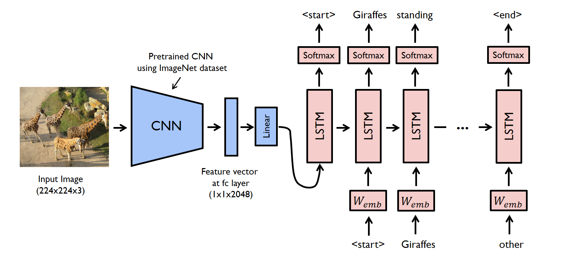
Architecture

Slide 6
cnn(convolutional neural network)
A CNN is a type of a neural network that is designed to process an image and represent it with a vector code. The architecture of CNN draws on fully-connected neural networks.
Convolutional Neural networks are specialized deep neural networks which can process the data that has input shape like a 2D matrix. Images are easily represented as a 2D matrix and CNN is very useful in working with images.
CNN is basically used for image classifications and identifying if an image is a bird, a plane or Superman, etc.

Slide 7
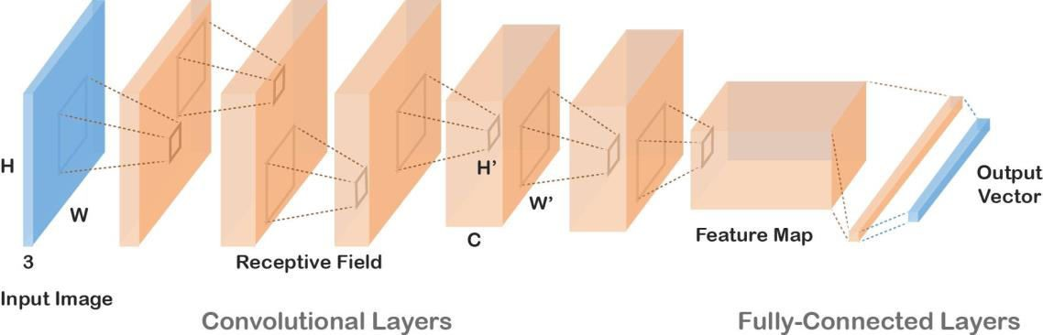

Slide 8
lstm
LSTM stands for Long short term memory, they are a type of RNN (recurrent neural network) which is well suited for sequence prediction problems.
It has proven itself effective from the traditional RNN by overcoming the limitations of RNN which had short term memory.
LSTM can carry out relevant information throughout the processing of inputs and with a forget gate, it discards non-relevant information.

Slide 9
modular division of project
Object detection
Sentence Generation
Ranking based caption retrieval

Slide 10

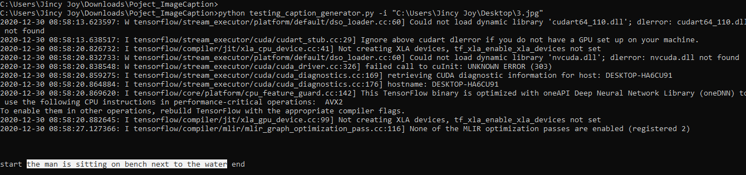

Slide 11
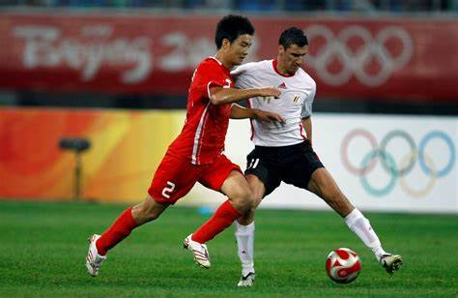
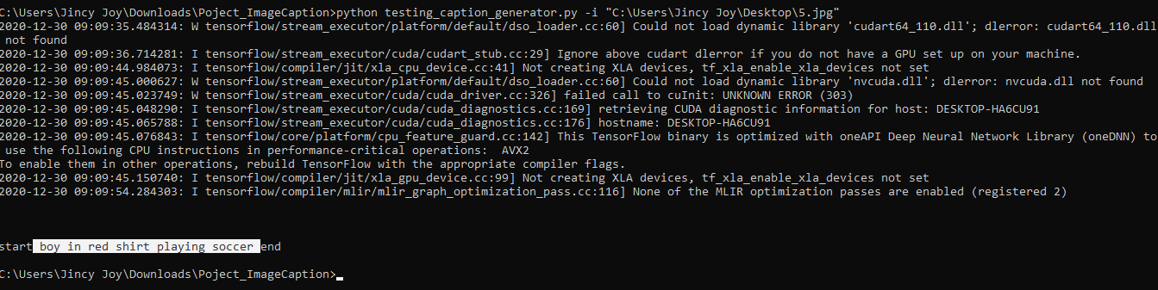

Slide 12
reference
Image Caption Generation Using Deep Learning (IEEE 2018), (https://ieeexplore.ieee.org/document/8697360)

Slide 13
THANK YOU…….…

